Slide 1
AJAX
Asynchronous JavaScript & XML

Slide 2
Agenda
AJAX, features & advantages
AJAX Simple Application – Date example
AJAX Suggest Application – Country Suggestion example
AJAX Database Application example
AJAX XML example
AJAX responseXML example

Slide 3
AJAX, Features and Advantages

Slide 4
Objectives:
In this session, we will be covering the following topics:
  What is AJAX ?
  AJAX for Rich Internet Applications
  AJAX – Advantages, working, HTTPRequests
  Technologies used in AJAX
  The XMLHttpRequest Object
  The Properties
    onreadystatechange Property
    The readyState Property
    The responseText Property
  Sending request to the server

Slide 5
What is AJAX ?
AJAX is abbreviation for Asynchronous JavaScript And XML
AJAX is not a new programming language, but a new technique that uses existing standards
AJAX is based on JavaScript and HTTP Requests
With AJAX, your JavaScript can communicate directly with the server, using JavaScript’s XMLHttpRequest object. With this object, JavaScript can exchange data with a web server without reloading the page
With AJAX you can increase your web application’s interactivity, speed and usability
Notes:
AJAX was coined by Jesse James Garret (Adaptive Path) in his blog article in 2005.

Slide 6
AJAX for Rich Internet Applications
Web applications have many benefits over desktop applications like:
  They can reach a larger audience
  They are easier to install and maintain
  They are easier & faster to develop
However , Internet Applications are not always as “rich” and user-friendly as traditional desktop applications
With AJAX , Internet Applications can be made richer and more user friendly

Slide 7
AJAX - Advantages
Real-time form data validation
Autocomplete
Autosave
Load on demand
Sophisticated user interface controls and effects
Refreshing data and server push
Partial submit
Page as an application

Slide 8
Technologies used in AJAX
AJAX is based on the following Web Standards:
JavaScript
  Loosely types scripting language, popularly used for client side apps
  Glue for the AJAX operation
DOM
  API for accessing and manipulating structured documents
  Represents the structure of XML and HTML documents
CSS
  Separates presentation style from content and may be changed dynamically by JavaScript
XMLHttpRequest
  JavaScript object that performs asynchronous interaction with the server

Slide 9
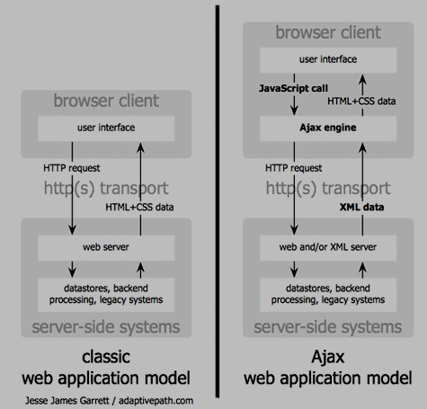
AJAX – How it works
Source: http://www.adaptivepath.com/ideas

Slide 10
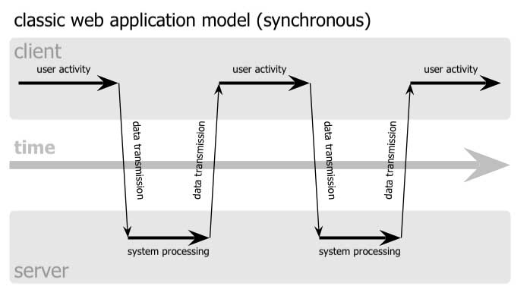
Classic Web Application Model
Synchronous
Source: James Garrett / adaptivepath.com

Slide 11
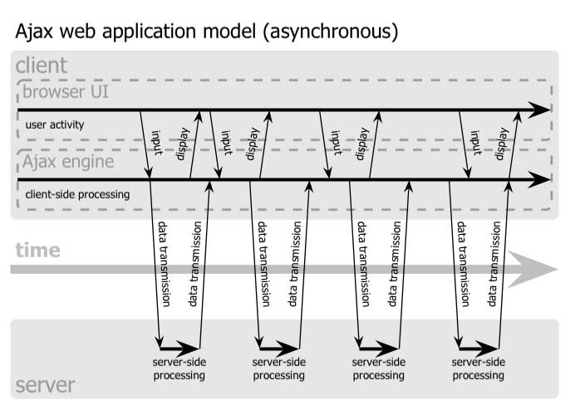
AJAX Web Application Model
Asynchronous

Slide 12
AJAX and HTTP Requests
Contrary to the traditional JavaScript working,
With AJAX, your JavaScript communicates directly with the server, using the JavaScript XMLHttpRequest object
With an HTTP request, a web page can make a request to, and get a response from a web server - without reloading the page
The user will stay on the same page, and will not notice that scripts request pages, or send data to a server in the background

Slide 13
The XMLHttpRequest Object
The keystone of AJAX is the XMLHttpRequest Object
By using the XMLHttpRequest object, a web developer can update a page with data from the server after the page has loaded
The XMLHttpRequest Object is supported in various browsers like Internet Explorer 5.0+ , Safari 1.2 , Mozilla 1.0/Firefox, Opera 8+, Chrome and Netscape 7
Different browsers use different methods to create the XMLHttpRequest Object (Internet Explorer uses an ActiveXObject, while other browsers uses the built-in JavaScript object called XMLHttpRequest)
Example:
var xmlHttp;
xmlHttp=new XMLHttpRequest(); //firefox, safari , opera 8.0+
xmlHttp=new ActiveXObject("Msxml2.XMLHTTP"); //IE 6.0+
xmlHttp=new ActiveXObject("Microsoft.XMLHTTP"); //IE 5.5+

Slide 14
The onreadystatechange Property
Once a request is made to the server, we also need to receive the data that is returned by the server through a function.
The onreadystatechange property stores the function that will process the response from a server.
The function that is stored in the onreadystatechange property is not a method, but is a function that is stored in the property to be called automatically.
Example: (The onreadystatechange property that stores an empty function inside it)
  xmlHttp.onreadystatechange=function() {
  //some code to handle the response/data returned by the server
  }

Slide 15
The readyState Property
The readyState property holds the status of the server’s response.
Each time the readyState changes, the onreadystatechange function will be executed.
The possible values for the readyState property:
State
Description
0
The request is not initialized
1
The request has been set up (Connection Established)
2
The request has been sent (request received)
3
The request is in process (answer in process)
4
The request is complete (finished)

Slide 16
The responseText Property
The data sent back from the server can be retrieved with the responseText property.
Example:
xmlHttp.onreadystatechange=function() {
if (xmlHttp.readyState==4) { document.myFormName.mytextboxname.value=xmlHttp.responseText;
}
}

Slide 17
The status Property
What if the server side script file did not exist?
  The readyState property will still be set to 4 on finish
  The responseText will now contain the error message
Use the “status” property to know the HTTP state of the server
HTTP status codes:
  401 : Unauthorized
  403 : Forbidden
  404 : Not Found
  200 : All OK
Notes:
Before I talk in depth about errors, it's worth talking about something you probably don't have to worry about when you're using Ajax -- redirections. In HTTP status codes, this is the 300 family of status codes, including:
301: Moved permanently
302: Found (the request was redirected to another URL/URI)
305: Use Proxy (the request must use a proxy to access the resource requested)
Ajax programmers probably aren't concerned about redirections for two reasons:
First, Ajax applications are almost always written for a specific server-side script, servlet, or application. For that component to disappear and move somewhere else without you, the Ajax programmer, knowing about it is pretty rare. So more often than not, you'll know that a resource has moved (because you moved it or had it moved), change the URL in your request, and never encounter this sort of result.
And an even more relevant reason is: Ajax applications and requests are sandboxed. This means that the domain that serves a Web page that makes Ajax requests is the domain that must respond to those requests. So a Web page served from ebay.com cannot make an Ajax-style request to a script running on amazon.com; Ajax applications on ibm.com cannot make requests to servlets running on netbeans.org.
As a result, your requests aren't able to be redirected to another server without generating a security error. In those cases, you won't get a status code at all. You'll usually just have a JavaScript error in the debug console. So, while you think about plenty of status codes, you can largely ignore the redirection codes altogether.

Slide 18
The status Property
xmlHttp.onreadystatechange=function() {
if (xmlHttp.readyState==4) {
if (xmlHttp.status == 200) {
document.myForm.mytextbox.value=xmlHttp.responseText;
}
else {
alert ("status is " + xmlHttp.status);
}
}
}

Slide 19
Sending a request to the server
To send a request to the server, we use the open() and the send() methods
The open() method: The open() method takes 3 arguments
  The first argument defines which method to use when sending the request (GET or POST)
  The second argument specifies the URL of the server-side script
  The third argument specifies whether the request should be handled asynchronously
The send() method:
  The send() method sends the request off to the server
Example:
xmlHttp.open("GET","server-side-script.asp",true);
xmlHttp.send(null);

Slide 20
Sending a request with GET
To send a request to the server using the GET method:
  Create the query string (like id=007&name=sridhar)
  Add the query string to the server-side URL, separated by a ? (like response.asp?id=007&name=sridhar)
  Pass null as the argument in the .send()
Example:
var params = "f1=" + f1 + "&f2=" + f2; // query string
xmlHttp.open("GET", "response.asp?" + params, true);
xmlHttp.send(null);

Slide 21
Sending a request with POST
To send a request to the server using the POST method:
  Add setRequestHeader property before sending
  Pass the query string as the argument in the .send()
Example:
var params = "f1=" + f1 + "&f2=" + f2; // query string
xmlHttp.open("POST", "response.asp", true);
xmlHttp.setRequestHeader("Content-type", "application/x-www-form-urlencoded");
xmlHttp.setRequestHeader("Connection", "close");
xmlHttp.send(params);

Slide 22
Summary
The Topics that were covered during this module were:
  What is AJAX ?
  Web Standards used in AJAX.
  Advantages and Working of AJAX
  The XMLHttpRequest Object
  The onreadystatechange Property
  The readyState Property
  The responseText Property
  Sending request to the server

Slide 23
AJAX Simple Application Example

Slide 24
Objectives:
In this module, we will ,
  Create a simple AJAX application which displays the server’s date in a text box of a html form.
  Host the files on the web server and run the application

Slide 25
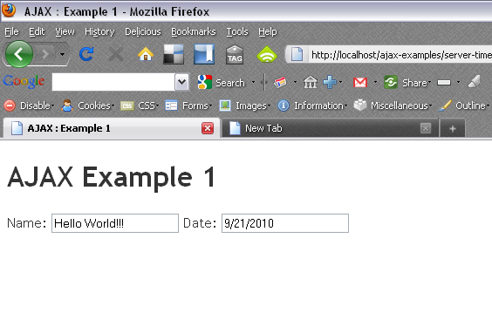
Simple Application - Intro
We are going to create a standard HTML form with two text fields: username and date. The username field will be filled in by the user and the date field will be filled in using AJAX.
Filled in by the user
Filled in using AJAX

Slide 26
Step 1: firstAjax.html (partial)
The HTML file will be named "firstAjax.html“
(notice that the HTML form below has no submit button!):
<html>
<body>
<form name="myForm">
Name: <input type="text" name="username" />
Date: <input type="text" name=“date" />
</form>
</body>
</html>

Slide 27
Step 2: Update firstAjax.html
Let's update our "firstAjax.html" file with the JavaScript that creates the XMLHttpRequest object:
<html><head>
<script type="text/javascript">
function ajaxFunction() {
var xmlHttp;
try {
// Firefox, Opera 8.0+, Safari
xmlHttp=new XMLHttpRequest();
}

Slide 28
Step 2: continued
catch (e) {
//Internet Explorer
try {
xmlHttp=new ActiveXObject("Msxml2.XMLHTTP");
}
catch (e) {
try {
xmlHttp=new ActiveXObject("Microsoft.XMLHTTP");
}

Slide 29
Step 2: continued
catch (e) {
alert("Your browser does not support AJAX!");
return false;
} // end try IE5.5
} // end try IE6
} // end try xmlHttp
} // end ajaxFunction ()
</script>
<form name="myForm">
Name: <input type="text" name="username" />
Date: <input type="text" name=“date" />
</form></body></html>

Slide 30
Step 3: Sending a request to the server
xmlHttp.open("GET",“date.asp",true);
xmlHttp.send(null);
Method to use when sending the request (GET/POST)
To specify that the request should be handled asynchronously.
URL/name of the server side script to call

Slide 31
Step 4: Link the AJAX function
Now we must decide when the AJAX function should be executed. We will let the function run "behind the scenes" when the user types something in the username text field:
<form name="myForm">
Name: <input type="text" onkeyup="ajaxFunction();" name="username" />
Date: <input type="text" name=“date" />
</form>

Slide 32
Step 5: Create Server Side ASP Script (date.asp)
We will now create the script (date.asp) that displays the current server date
<%
response.expires=-1
response.write(date())
%>
The responseText property of the XMLHttp object will store the data that is returned from the server (server script). Here we want to send back the current date that would get stored in the responseText property

Slide 33
Updated firstAjax.html file
<html><head>
<script type="text/javascript">
function ajaxFunction() {
var xmlHttp;
try {
// Firefox, Opera 8.0+, Safari
xmlHttp=new XMLHttpRequest();
}

Slide 34
Updated firstAjax.html file – cont’d
catch (e) {
//Internet Explorer
try {
xmlHttp=new ActiveXObject("Msxml2.XMLHTTP");
}
catch (e) {
try {
xmlHttp=new ActiveXObject("Microsoft.XMLHTTP");
}

Slide 35
Updated firstAjax.html file – cont’d
catch (e) {
alert("Your browser does not support AJAX!");
return false;
}
}
}
xmlHttp.onreadystatechange=function() {
if(xmlHttp.readyState==4) {
document.myForm.date.value=xmlHttp.responseText;
}
}

Slide 36
Updated firstAjax.html file – cont’d
xmlHttp.open("GET",“date.asp",true);
xmlHttp.send(null);
}
</script>
</head>
<body>
<form name="myForm">
Name: <input type="text" onkeyup="ajaxFunction();" name="username" />
Date: <input type="text" name=“date" />
</form></body></html>

Slide 37

Step 6: Run your AJAX Application
Save all your files (html, asp) in a directory and host it on the web server.
Now open the firstAjax.html in the browser by providing the appropriate URL.
Try the AJAX application by typing some text into the Name text box which would show the date in the ‘date’ textbox.
(The date text box gets the server's date from "date.asp" file without reloading the page! )

Slide 38
Summary
In this module, we learnt,
  How to create a simple AJAX application which displays the server’s date in a text box of a html form without reloading the page

Slide 39
AJAX Suggest Application Example

Slide 40
Objectives
In this module, we will
  Demonstrate how a web page can communicate with a web server online as a user enters data into a standard HTML form and give suggestions

Slide 41
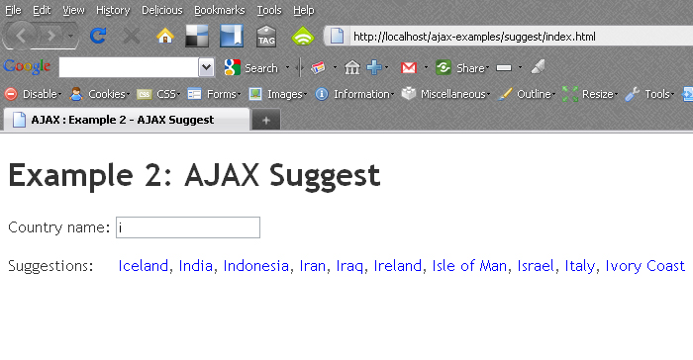
Ajax Suggest Application : Intro
User types the name here
Suggestion given by the application

Slide 42
Step 1: Create the html file (suggest.html)
<html>
<head>
<script src="countryhint.js"></script>
</head>
<body>
<form>
Country name: <input type="text" id="txt1" onkeyup="showHint(this.value)">
</form>
<p>Suggestions: <span id="txtHint"></span></p>
</body>
</html>

Slide 43
Step 2: Create countryhint.js JavaScript
var xmlHttp
function showHint(str) {
if (str.length==0) {
document.getElementById("txtHint").innerHTML="";
return;
}
xmlHttp=GetXmlHttpObject();
if (xmlHttp==null) {
alert ("Your browser does not support AJAX!");
return;
}

Slide 44
Step 2: continued
var url="countries.asp";
url=url+"?q="+str;
url=url+"&sid="+Math.random();
xmlHttp.onreadystatechange=stateChanged;
xmlHttp.open("GET",url,true);
xmlHttp.send(null);
}
function stateChanged() {
if (xmlHttp.readyState==4) { document.getElementById("txtHint").innerHTML=xmlHttp.responseText;
}
}

Slide 45
Step 2: continued
function GetXmlHttpObject() {
var xmlHttp=null;
try {
xmlHttp=new XMLHttpRequest();
}
catch (e) {
try {
xmlHttp=new ActiveXObject("Msxml2.XMLHTTP");
}
catch (e) {
xmlHttp=new ActiveXObject("Microsoft.XMLHTTP");
}
}
return xmlHttp;
}

Slide 46
Step 3: create countries.asp file
<%
response.expires=-1
dim a(10)
dim cString
'Create an array of country names
mycountries="Australia, Bahamas, Cambodia, Denmark, Egypt, Finland, Germany, Hungary, India, Japan"
a=Split(mycountries,",")
'get the q parameter from URL
q=ucase(request.querystring("q"))

Slide 47
Step 3: continued
'lookup all hints from array if length of q>0
if len(q)>0 then
hint=""
for i=0 to 10
if q=ucase(mid(a(i),1,len(q))) then
if hint="" then
hint=a(i)
else
hint=hint & " , " & a(i)
end if
end if
next
end if

Slide 48
Step 3: continued
'Output "no suggestion" if no hint were found
'or output the correct values
if hint="" then
response.write("no suggestion")
else
response.write(hint)
end if
%>

Slide 49
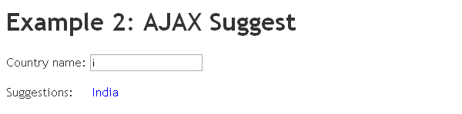
Step 4: Run your Application
Save all your files (html, javascript, asp/php) in a directory and host it on the web server.
Now open the suggest.html in the browser by providing the proper URL.
As you start typing in the text box, the suggestion is displayed in the span area.

Slide 50
Summary
In this module, we learnt
  How a web page can communicate with a web server online as a user enters data into a standard HTML form and give suggestions
  We used html, javascript, asp for building our application

Slide 51
AJAX Database Application

Slide 52
Objectives
In this module we will,
  Demonstrate how AJAX can be used for interactive communication with a database.
  The module will discuss an example to demonstrate how a web page can fetch information from a database using AJAX technology.

Slide 53
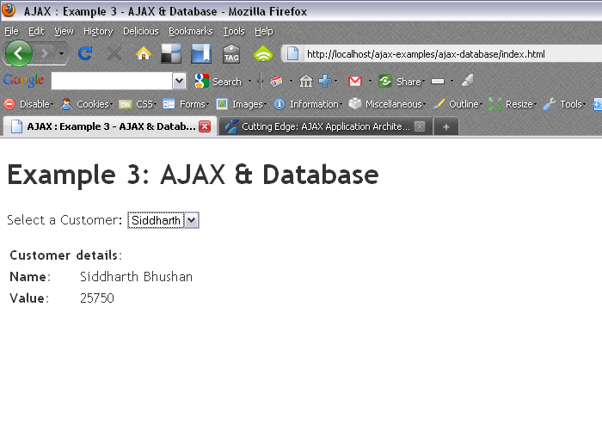
Ajax Database Example: Intro
User selects the name
Info is picked up from the db and displayed here

Slide 54
Step 1: Create html file (customer.html)
<html><head>
<script src="selectcustomer.js"></script>
</head><body>
<form>
Select a Customer:
<select name="customers" onchange="showCustomer(this.value)">
<option value="Keerthi">Keethi</option>
<option value="Rahul">Rahul</option>
<option value="Siddharth">Siddharth</option>
</select>
</form>
<p><div id="txtHint">Customer info will be listed here.</div></p>
</body></html>

Slide 55
Step 2: Create javascript file (selectcustomer.js)
var xmlHttp
function showCustomer(str) {
xmlHttp=GetXmlHttpObject();
if (xmlHttp==null) {
alert ("Your browser does not support AJAX!");
return;
}
var url="getcustomer.asp";
url=url+"?q="+str;
url=url+"&sid="+Math.random();
xmlHttp.onreadystatechange=stateChanged;
xmlHttp.open("GET",url,true);
xmlHttp.send(null);
}

Slide 56
Step 2: continued
function stateChanged() {
if (xmlHttp.readyState==4) { document.getElementById("txtHint").innerHTML=xmlHttp.responseText;
}
}
function GetXmlHttpObject() {
var xmlHttp=null;
try {
xmlHttp=new XMLHttpRequest();
}

Slide 57
Step 2: continued
catch (e) {
try {
xmlHttp=new ActiveXObject("Msxml2.XMLHTTP");
}
catch (e) {
xmlHttp=new ActiveXObject("Microsoft.XMLHTTP");
}
}
return xmlHttp;
}

Slide 58
Step 3: The server side script (getcustomer.asp)
<%
response.expires=-1
sql="SELECT * FROM CUSTOMERS WHERE CUSTOMERID="
sql=sql & "'" & request.querystring("q") & "'"
set conn=Server.CreateObject("ADODB.Connection")
conn.Provider="Microsoft.Jet.OLEDB.4.0"
conn.Open(Server.Mappath("customer.mdb"))
set rs = Server.CreateObject("ADODB.recordset")
rs.Open sql, conn

Slide 59
Step 3: continued
response.write("<table>")
do until rs.EOF
for each x in rs.Fields
response.write("<tr><td><b>" & x.name & "</b></td>")
response.write("<td>" & x.value & "</td></tr>")
next
rs.MoveNext
loop
response.write("</table>")
%>

Slide 60
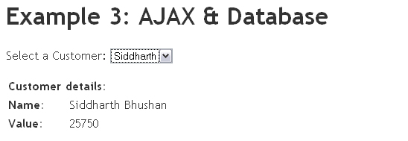
Step 4: Run the Application
Save all your files (html, javascript, asp/database) in a directory and host it on the web server.
Now open the customer.html in the browser by providing the proper URL.
Once you select the name of the customer from the drop down box , the information about the customer is displayed in the div area just below the form area without reloading the page.

Slide 61
Summary:
In this module we learnt,
  How AJAX can be used for interactive communication with a database
  The module also demonstrated how a web page can fetch information from a database using AJAX technology

Slide 62
AJAX XML Application

Slide 63
Objectives:
In this module, we will see,
  How AJAX can be used for interactive communication with an XML file
  We will demonstrate how a web page can fetch information from an XML file using AJAX technology

Slide 64
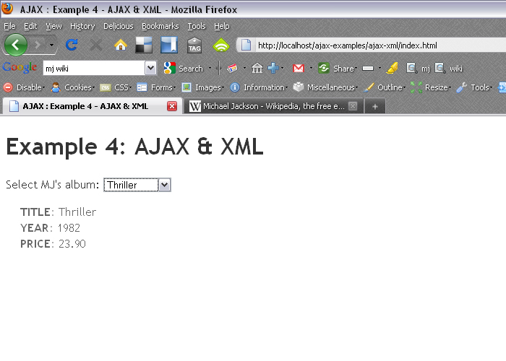
AJAX XML Application
Choose the name of the artist
CD details are displayed here

Slide 65
Step 1: Create the html file (album.html)
<html><head>
<script src="select.js"></script>
</head><body>
<form>
Select album:
<select name= "album" onchange="showAlbum(this.value)">
<option value= "Thriller">Thriller</option>
<option value= "Dangerous">Dangerous</option>
<option value= "History">HIStory</option>
</select>
</form>
<p><div id="txtHint">Album info will be listed here.</div></p>
</body></html>

Slide 66
Step 2: Create select.js javascript file
var xmlHttp
function showAlbum(str) {
xmlHttp=GetXmlHttpObject();
if (xmlHttp==null) {
alert ("Your browser does not support AJAX!");
return;
}
var url="getalbum.asp";
url=url+"?q="+str;
url=url+"&sid="+Math.random();
xmlHttp.onreadystatechange=stateChanged;
xmlHttp.open("GET",url,true);
xmlHttp.send(null);
}

Slide 67
Step 2: continued
function stateChanged() {
if (xmlHttp.readyState==4) {
document.getElementById("txtHint").innerHTML=xmlHttp.responseText;
}
}
function GetXmlHttpObject() {
var xmlHttp=null;
try {
// Firefox, Opera 8.0+, Safari
xmlHttp=new XMLHttpRequest();
}

Slide 68
Step 2: continued
catch (e) {
// Internet Explorer
try {
xmlHttp=new ActiveXObject("Msxml2.XMLHTTP");
}
catch (e) {
xmlHttp=new ActiveXObject("Microsoft.XMLHTTP");
}
}
return xmlHttp;
}

Slide 69
Step 3: Create catalog.xml file
<?xml version="1.0" encoding="ISO-8859-1" ?>
<CATALOG>
<ALBUM>
<TITLE>Thriller</TITLE>
<YEAR>1982</YEAR>
<PRICE>23.90</PRICE>
</ALBUM>
<ALBUM>
<TITLE>Dangerous</TITLE>
<YEAR>1991</YEAR>
<PRICE>29.90</PRICE>
</ALBUM>
<ALBUM>
<TITLE>History</TITLE>
<YEAR>1995</YEAR>
<PRICE>19.90</PRICE>
</ALBUM>
</CATALOG>

Slide 70
Step 4: Create getalbum.asp
<%
response.expires=-1
q=request.querystring("q")
set xmlDoc=Server.CreateObject("Microsoft.XMLDOM")
xmlDoc.async="false"
xmlDoc.load(Server.MapPath("catalog.xml"))
set nodes=xmlDoc.selectNodes("CATALOG/ALBUM[TITLE='" & q & "']")
for each x in nodes
for each y in x.childnodes
response.write("<b>" & y.nodename & ":</b> ")
response.write(y.text)
response.write("<br />")
next
next
%>

Slide 71
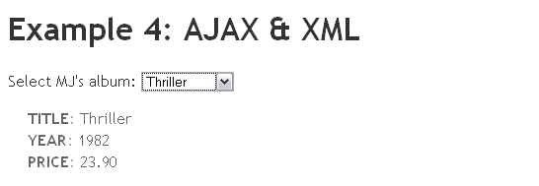
Step 5: Run your Application
Save all your files (html, javascript, asp, xml) in a directory and host it on the web server.
Now open the album.html in the browser by providing the proper URL.
Once you select the name of the album from the drop down box, the information about the album is displayed in the div area just below the form area without the page getting reloaded.

Slide 72
Summary
In this module, we learnt,
  How AJAX can be used for interactive communication with an XML file
  We also demonstrated how a web page can fetch information from a XML file using AJAX technology

Slide 73
AJAX ResponseXML Application

Slide 74
Objective:
In this module, we will
  Demonstrate how a web page can fetch information from a database using AJAX technology. The selected data this time will be converted to an XML document, and then we will use the DOM to extract the values to be displayed

Slide 75
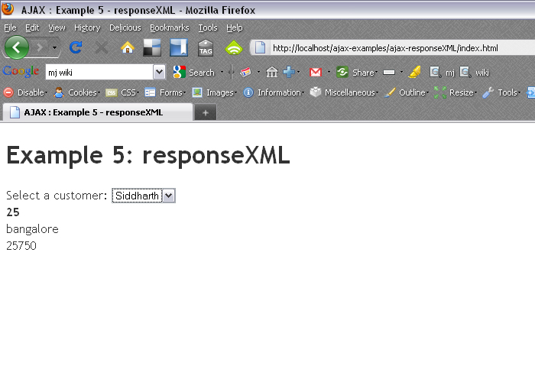
AJAX responseXML Application :Intro
User selects the customer name
Data extracted from database, converted as xml and displayed using DOM

Slide 76
XML Response
If the server returns the data as XML, and sets a Content-Type response header of “text/xml”, the browser creates a DOM tree to represent that XML.
The browser puts a reference to that DOM tree in the request object’s responseXML property
To use the DOM to work on that XML data, use responseXML instead of responseText with request object
The DOM for the web page represents HTML and the DOM for XML represents the server’s response
You work with both DOM trees in the same way, as they have same methods

Slide 77
XML DOM
The XML DOM (Document Object Model) is:
  A standard object model for XML
  A standard programming interface for XML
  Platform- and language-independent
  A W3C standard
The DOM presents an XML document as a tree structure, with elements, attributes, and text as nodes
The XML DOM defines the objects and properties of all XML elements, and the methods (interface) to access them

Slide 78
XML DOM Node Tree
E.g.:
<bookstore>
<book category="webtech">
<title lang="en">AJAX in Action</title>
<author>Dave Crane</author>
<year>2006</year>
<price>49.99</price>
</book>
</bookstore>
In the XML above, the <title> element is the first child of the <book> element, and the <price> element is the last child of the <book> element.
Furthermore, the <book> element is the parent node of the <title>, <author>, <year>, and <price> elements.

Slide 79
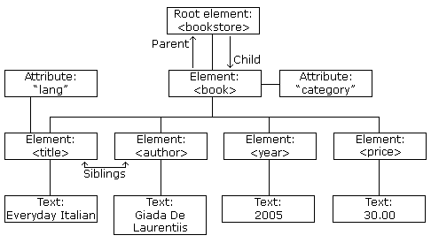
XML DOM Node Tree (contd.).

Slide 80
XML DOM Node Tree (contd.).
In a node tree, the top node is called the root
Every node, except the root, has exactly one parent node
A node can have any number of children (child nodes)
A leaf is a node with no children
Siblings are nodes with the same parent

Slide 81
Parsing XML
All modern browsers have a built-in XML parser that can be used to read and manipulate XML.
The parser reads XML into memory and converts it into an XML DOM object that can be accessed with JavaScript
For e.g., in Microsoft IE, to load XML file(books.xml):
xmlDoc=new ActiveXObject("Microsoft.XMLDOM");
xmlDoc.async="false";
xmlDoc.load("books.xml");
All parsers contain functions to traverse XML trees, access, insert, and delete nodes

Slide 82
XML DOM Properties & Methods
XML DOM Properties
  x.nodeName - the name of x
  x.nodeValue - the value of x
  x.parentNode - the parent node of x
  x.childNodes - the child nodes of x
  x.attributes - the attributes nodes of x
XML DOM Methods
  x.getElementsByTagName(name) - get all elements with a specified tag name
  x.appendChild(node) - insert a child node to x
  x.removeChild(node) - remove a child node from x
Note: In the list above, x is a node object.

Slide 83
Step 1: Create the html file (cust.html)
<html>
<head>
<script src="select_xml.js"></script>
</head>
<body>
<form>
Select a customer:
<select name= "customer" onchange="showDetails(this.value)">
<option value= "keerthi">Keerthi</option>
<option value= "rahul">Rahul</option>
<option value= "siddharth">Siddharth</option>
</select>
</form>

Slide 84
Step 1: continued
<strong><span id="age"></span></strong><br />
<span id="city"></span><br />
<span id="value"></span>
</body>
</html>

Slide 85
Step 2: Create javascript file (select_xml.js )
var xmlHttp
function showDetails(str) {
xmlHttp=GetXmlHttpObject();
if (xmlHttp==null) {
alert ("Your browser does not support AJAX!");
return;
}
var url="getcustomer.asp";
url=url+"?q="+str;
url=url+"&sid="+Math.random();
xmlHttp.onreadystatechange=stateChanged;
xmlHttp.open("GET",url,true);
xmlHttp.send(null);
}

Slide 86
Step 2: continued
function stateChanged() {
if (xmlHttp.readyState==4) {
var xmlDoc=xmlHttp.responseXML.documentElement;
document.getElementById("age").innerHTML=
xmlDoc.getElementsByTagName("age")[0].childNodes[0].nodeValue;
document.getElementById("city").innerHTML=
xmlDoc.getElementsByTagName("city")[0].childNodes[0].nodeValue;
document.getElementById("value").innerHTML=
xmlDoc.getElementsByTagName("value")[0].childNodes[0].nodeValue;

Slide 87
Step 2: continued
}
}
function GetXmlHttpObject() {
var xmlHttp=null;
try {
// Firefox, Opera 8.0+, Safari
xmlHttp=new XMLHttpRequest();
}

Slide 88
Step 2: continued
catch (e) {
// Internet Explorer
try {
xmlHttp=new ActiveXObject("Msxml2.XMLHTTP");
}
catch (e) {
xmlHttp=new ActiveXObject("Microsoft.XMLHTTP");
}
}
return xmlHttp;
}

Slide 89
Step 3: Create getcustomer.asp
<%
response.expires=-1
response.contenttype="text/xml"
sql="SELECT * FROM CUSTOMERS "
sql=sql & " WHERE NAME='" & request.querystring("q") & "'"
on error resume next
set conn=Server.CreateObject("ADODB.Connection")
conn.Provider="Microsoft.Jet.OLEDB.4.0"
conn.Open(Server.Mappath("customer.mdb"))
set rs=Server.CreateObject("ADODB.recordset")
rs.Open sql, conn
if err <> 0 then
response.write(err.description)
set rs=nothing
set conn=nothing
else

Slide 90
Step 3: continued
response.write("<?xml version='1.0' encoding='ISO-8859-1'?>")
response.write("<customer>")
response.write("<name>" &rs.fields("name")& "</name>")
response.write("<age>" &rs.fields("age")& "</age>")
response.write("<city>" &rs.fields("city")& "</city>")
response.write("<value>" &rs.fields("value")& "</value>")
response.write("</customer>")
end if
on error goto 0
%>

Slide 91
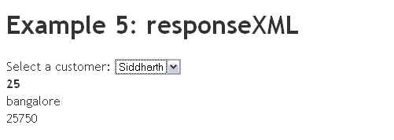
Step 4: Run the application
Save all your files (html, javascript, asp, database) in a directory and host it on the web server.
Now open the cust.html in the browser by providing the proper URL.
Once you select the name of the customer from the drop down box, the information about the customer is returned as a xml & then displayed in the span area just below the form area

Slide 92
Summary
In this module, we
  Demonstrated how a web page can fetch information from a database using AJAX technology and how the data from the database was converted to an XML document, and then used the DOM to extract the values to be displayed

Slide 93
AJAX JSON Example

Slide 94
AJAX - JSON
JSON stands for JavaScript Object Notation
It is a text-based format for representing simple data structures & associative arrays
Simple JSON & XML example:

Slide 95
JSON – XML Comparison
JSON
{
"menu": "File",
"commands": [
{
"title": "New",
"action":"CreateDoc"
},
{
"title": "Open",
"action": "OpenDoc"
},
{
"title": "Close",
"action": "CloseDoc"
}
]
}
XML
<?xml version="1.0" ?>
<root>
<menu>File</menu>
<commands>
<item>
<title>New</value>
<action>CreateDoc</action>
</item>
<item>
<title>Open</value>
<action>OpenDoc</action>
</item>
<item>
<title>Close</value>
<action>CloseDoc</action>
</item>
</commands>
</root>

Slide 96
Create the example.html file
<html xmlns="http://www.w3.org/1999/xhtml">
<head>
<title>AJAX JSON</title>
<script type="text/javascript" src="ajax.js"></script>
</head>
<body>
<label>
<input name="button2" type="button" id="button2" value="Load JSON" onclick="ajaxFunction()" />
</label>
</body>
</html>

Slide 97
Create ajax.js file
function ajaxFunction() {
var xmlHttp = GetXmlHttpObject();
if(xmlHttp == null) {
alert("Your browser does not support Ajax.");
return;
}
xmlHttp.open("GET", "students.json", true);
xmlHttp.send(null);
xmlHttp.onreadystatechange = function() {

Slide 98
Ajax.js (cont’d)
if(xmlHttp.readyState == 4) {
var jsonT = eval('('+ xmlHttp.responseText +')');
var str='<table>';
str=str+'<tbody id="webstudnts">';
str=str+'<tr style="background-color:#dbb;">';
str=str+'<td>Id</td><td>Name</td><td>Legacy skill</td>';
document.write(str);
for(i=0; i<3; i++){
document.write("<tr><td>" +jsonT.wclass[i].student.id+ "</td><td>" +
jsonT.wclass[i].name+ "</td><td> " +
jsonT.wclass[i].legacySkill +"</td></tr>");
}
document.write("</tbody></table>");
}
} // onreadystatechange
} // end ajaxFunction

Slide 99
Ajax.js (cont’d)
function GetXmlHttpObject() {
var xmlHttp;
try {
xmlHttp = new XMLHttpRequest(); // for ff, safari, ...
}
catch (e) {
try {
xmlHttp = new ActiveXObject("Msxml2.XMLHTTP"); // IE6+
}
catch (e) {
try {
xmlHttp = new ActiveXObject("Microsoft.XMLHTTP"); // IE5.5+
}
catch (e) {
//alert("Your browser does not support AJAX.");
return false;
}
}
} // try
return xmlHttp;
}// GetXmlHttpObject

Slide 100
Create students.json file
{"wclass":
[{"student":{"id":"1"},"name":"Raghunath Sridhar", "legacySkill":"Access, VB 5.0"},
{"student":{"id":"2"},"name":"Manjunath Rao", "legacySkill":"Cobol, MainFrame"},
{"student":{"id":"3"},"name":"Navin Rungta", "legacySkill":"HTML, XML"}]}

Slide 101
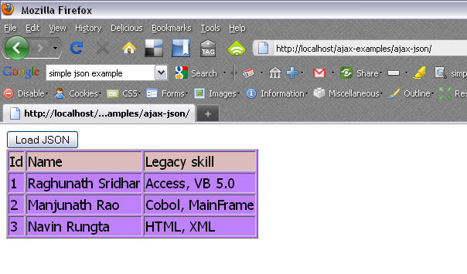
Run your html file

Slide 102
Summary
In this module, we
  Demonstrated how a web page can fetch information from a JSON source using AJAX technology and then use the built-in JSON parser to extract the values to be displayed

Slide 103
Caveats
AJAX & Same Origin Policy

Slide 104
Same Origin Policy
Same-origin Policy prevents a document loaded from one site to access a document from another site
The site here refers to the domain name, port, and protocol of the site hosting the document
So, if your document is http://www.example.com/page.html, then your XmlHttpRequest can access any page on http://www.example.com, but not these:
  http://www.example.com:81/other.html (different port)
  https://www.example.com/dir/other.html (different protocol)
  http://en.example.com/dir/other.html (different host)
  http://example.com/dir/other.html (different host)

Slide 105
Same Origin Policy (cont'd)
Same-origin Policy was originally released with Netscape 2.0 and then on, every major browser incorporates it
The Threat: Absence of this security measure, allows XSS (cross site scripting) & could lead to
  Impersonation of a Legitimate User
  Impersonation of a Legitimate Website
Workarounds: Though there are many workarounds, the most popular are:
  Loading external scripts using JSONP (JSON with Padding)
  Setting up a Reverse Proxy directive if running on Apache
  Setting a document.domain value in the JavaScript on the target server to allow the other site to access resources through AJAX

Slide 106
References
Ajax: A New Approach to Web Applications
(http://adaptivepath.com/ideas/essays/archives/000385.php)
Ajax Web Tutorial
(http://www.tutorialspoint.com)
Ajax in Action
by Dave Crane, Eric Pascarello with Darren James
2006 Manning Publications Co.

Slide 107
Thank you

